Slide 1

Project 3
Team 1:
Ramirez Moreno Diana Gabriela
Medina Gómez Alejandro
Sánchez Zepeda Esteban Tonatiuh
Castro Chabolla Rodolfo

Slide 2
Introduction
Netflix is one of the most popular streaming services in the world, with over 222 million subscribers as of 2023. The company offers a wide variety of movies and TV shows, from classic films to new releases.
A Netflix movies and shows database project would allow users to explore the company's vast catalog of content. The database could be used to answer questions such as:
What country has more movies and TV shows on Netflix?
Which genre is the most popular?
What year has more movies?
Which country has the highest average score?
The database could also be used to track the performance of Netflix's content over time. This information could be used to help Netflix make decisions about what content to produce and acquire in the future.

Slide 3

The database

Slide 4

Our database was created parting from a CSV file called movies.csv wich features a collection of 5145 rows and 15 columns.

Slide 5
The original columns were the following
id
title
type
description
release_year
age_certification
runtime
genres
production_countries
seasons
imdb_id
imdb_score
imdb_votes
tmdb_popularity
tmdb_score

Slide 6
Data cleaning
We proceeded to cut the following columns since they where irrelevant to our analysis ['id','imdb_votes', 'tmdb_popularity', 'imdb_id']

Slide 7
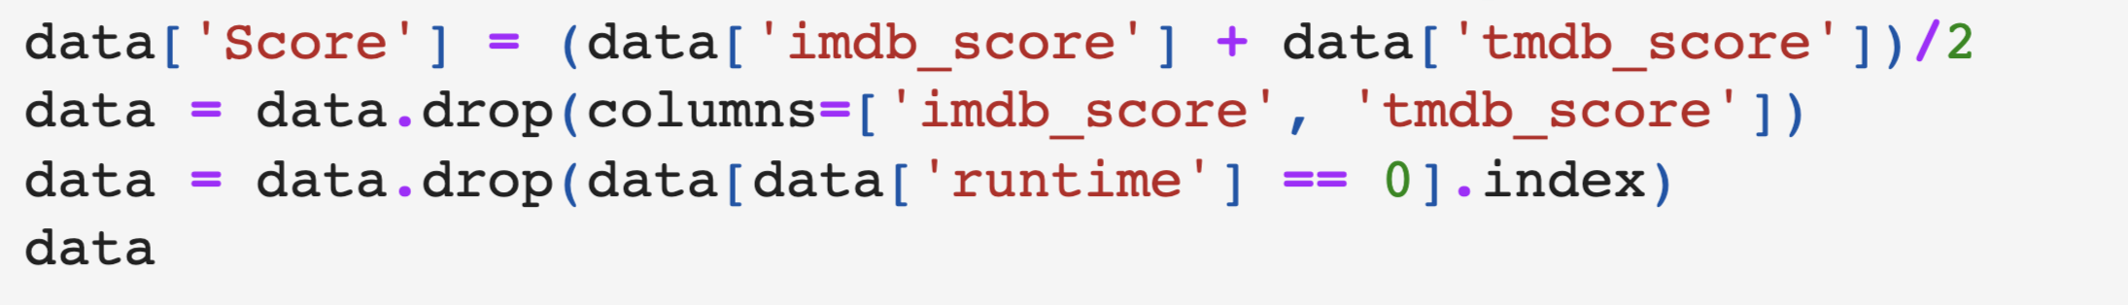
We made a column with the average score and drop the other two scores;
We also dropped shows with no runtime

Slide 8
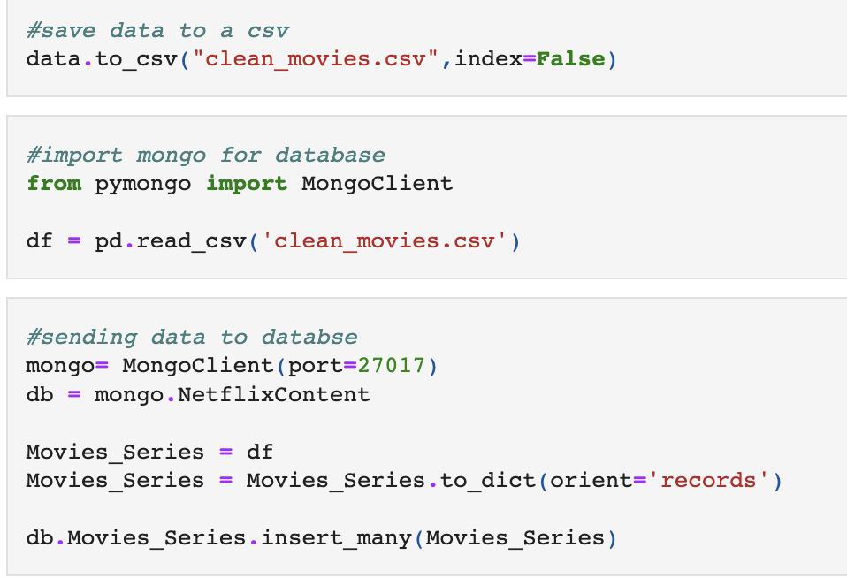
After that we corrected some of the data and dropped the missing values
The final database was 5137 rows × 10 columns
In the end we sent the data to our database

Slide 9

MongoDB database
We choose mongo DB for working with our dataset
The new title of our dataset is netflix

Slide 10
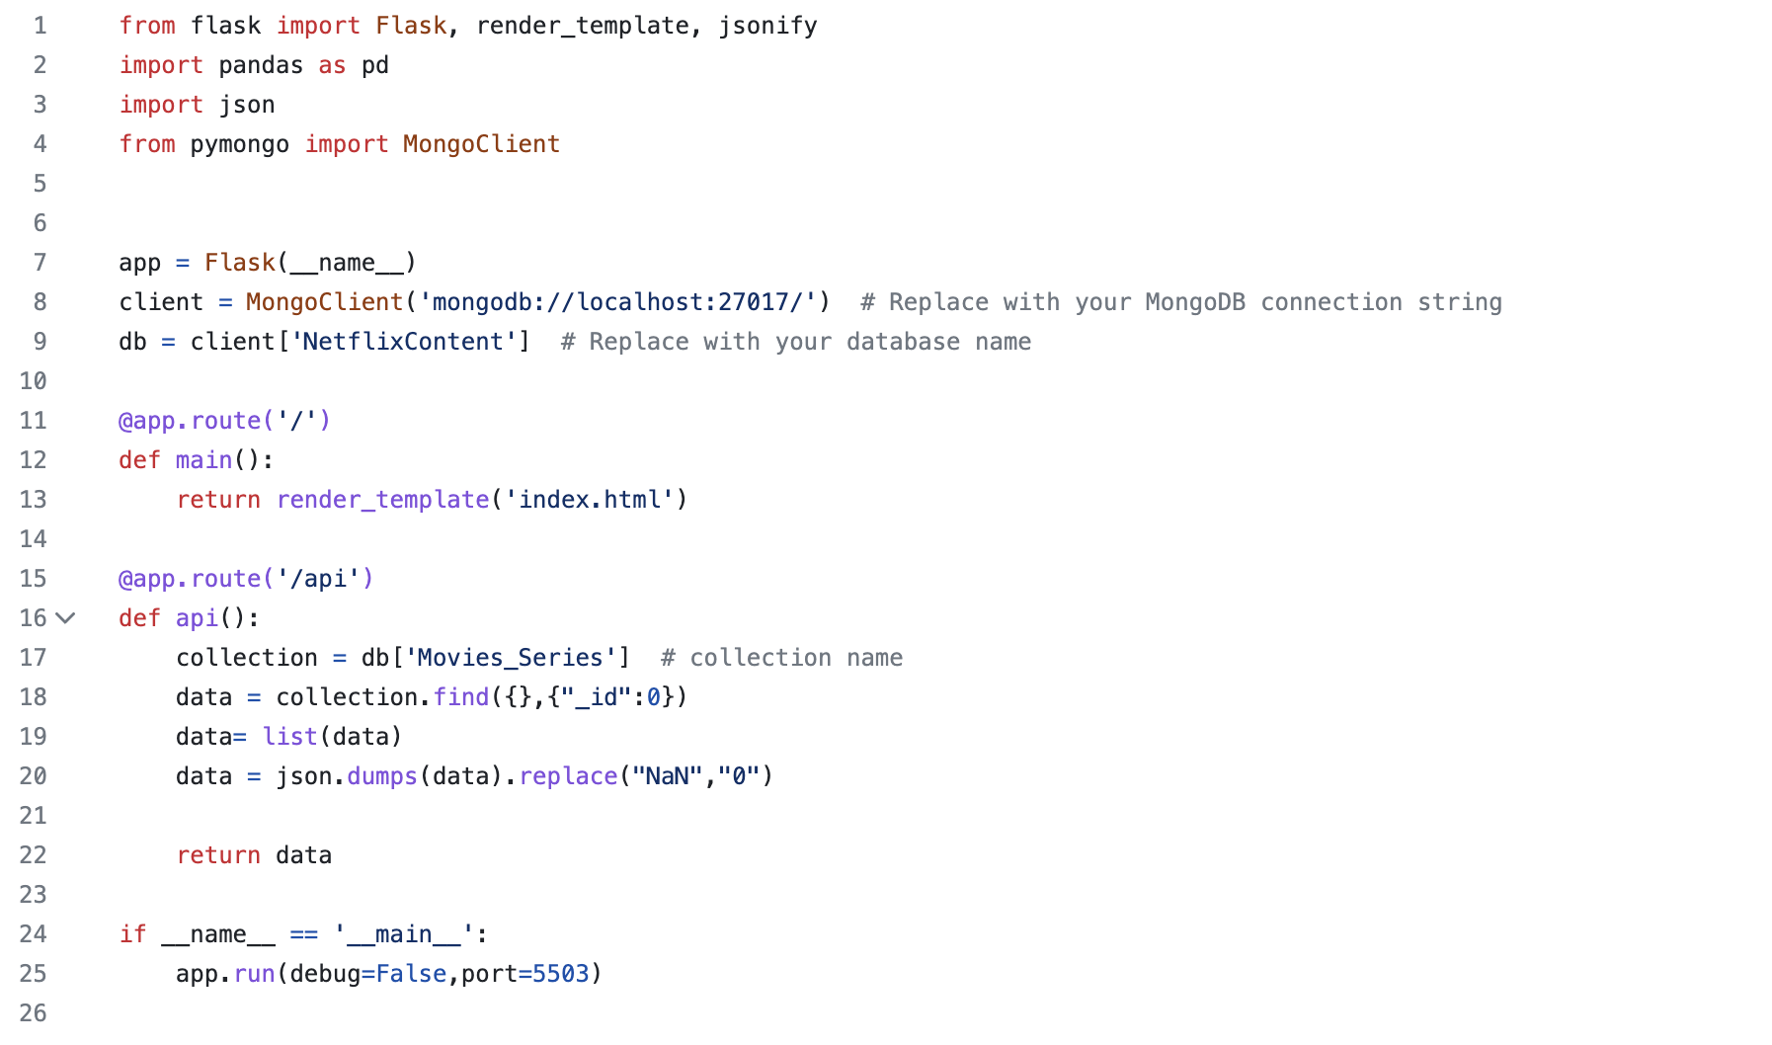
Python Flask-powered API

Slide 11

HTML/CSS

Slide 12

Visualization
Our dashboard features the next user driven interactions:
A dropdown that allows a user to select a value from a series of options.
A menu
Four different interactive Visualizations

Slide 13
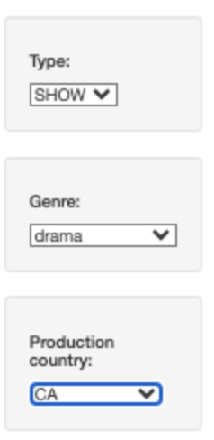
The three interactive options that we used to display different information in our dashboard are the following.
Type
Genre
Production Country

Slide 14
The visualizations
Barchart
Bubble chart
Map chart
Text box

Slide 15
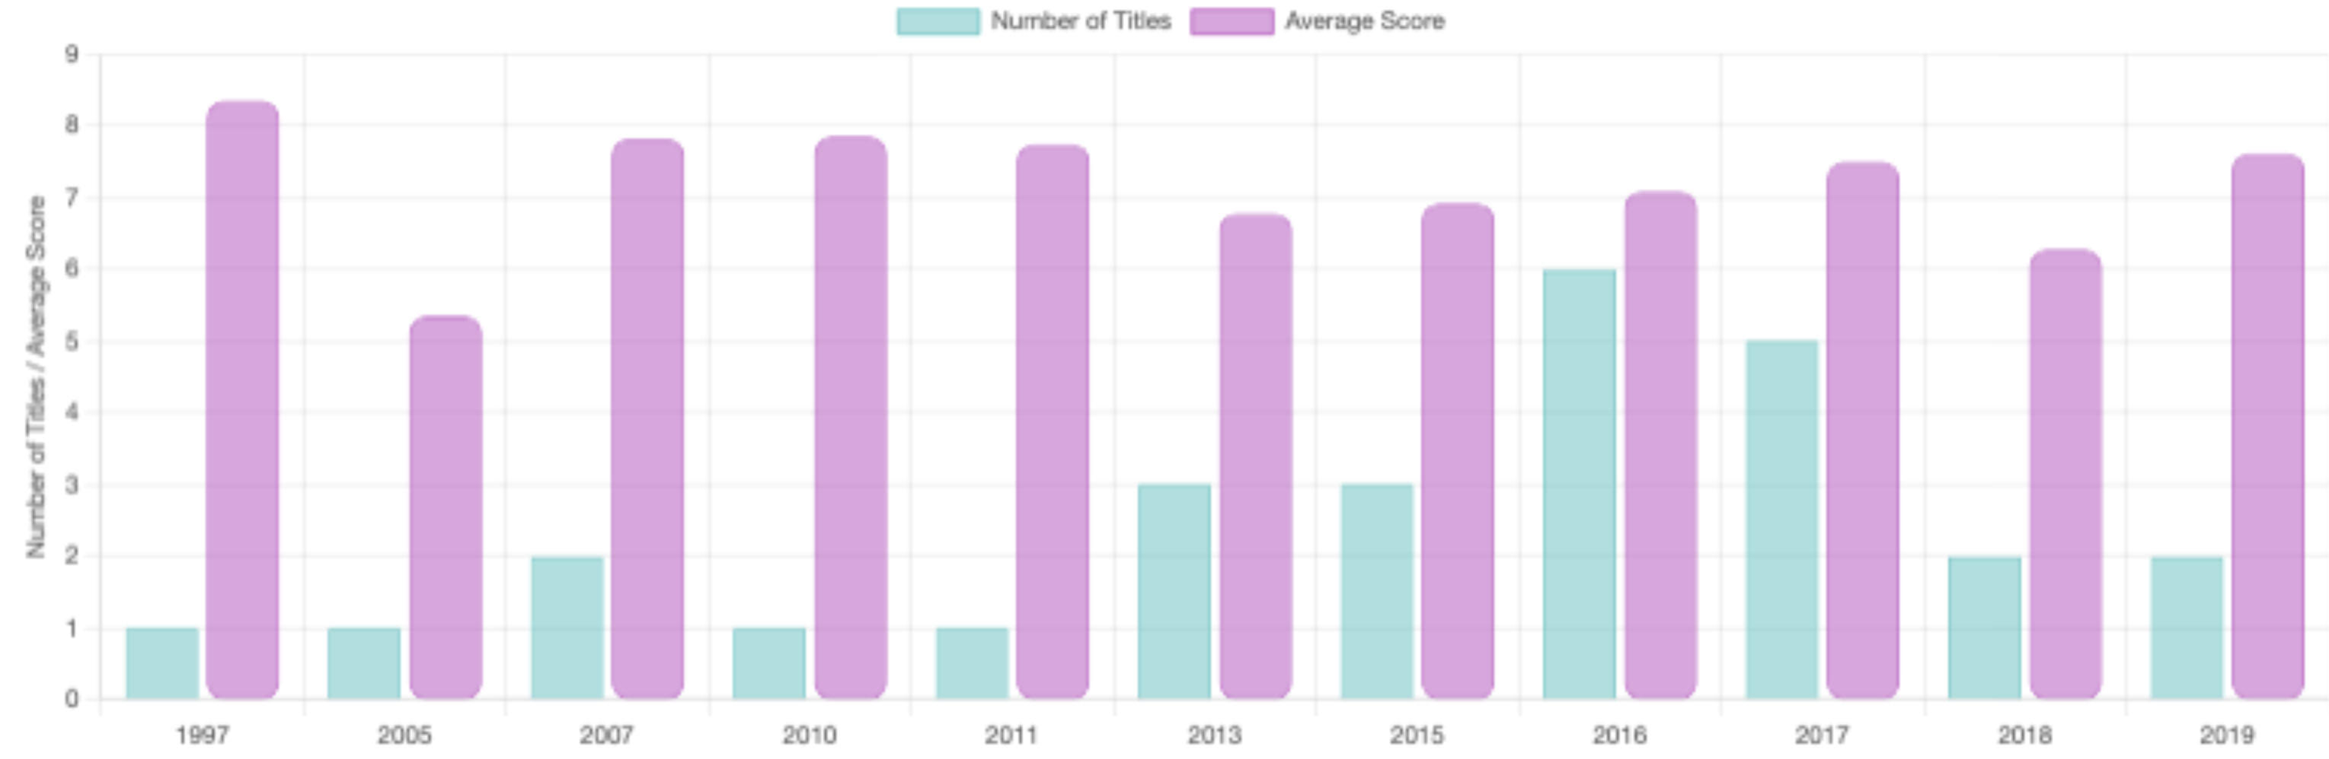
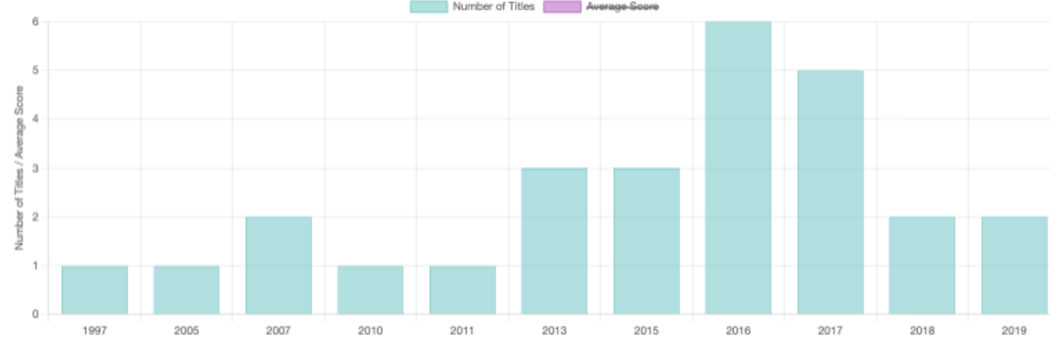
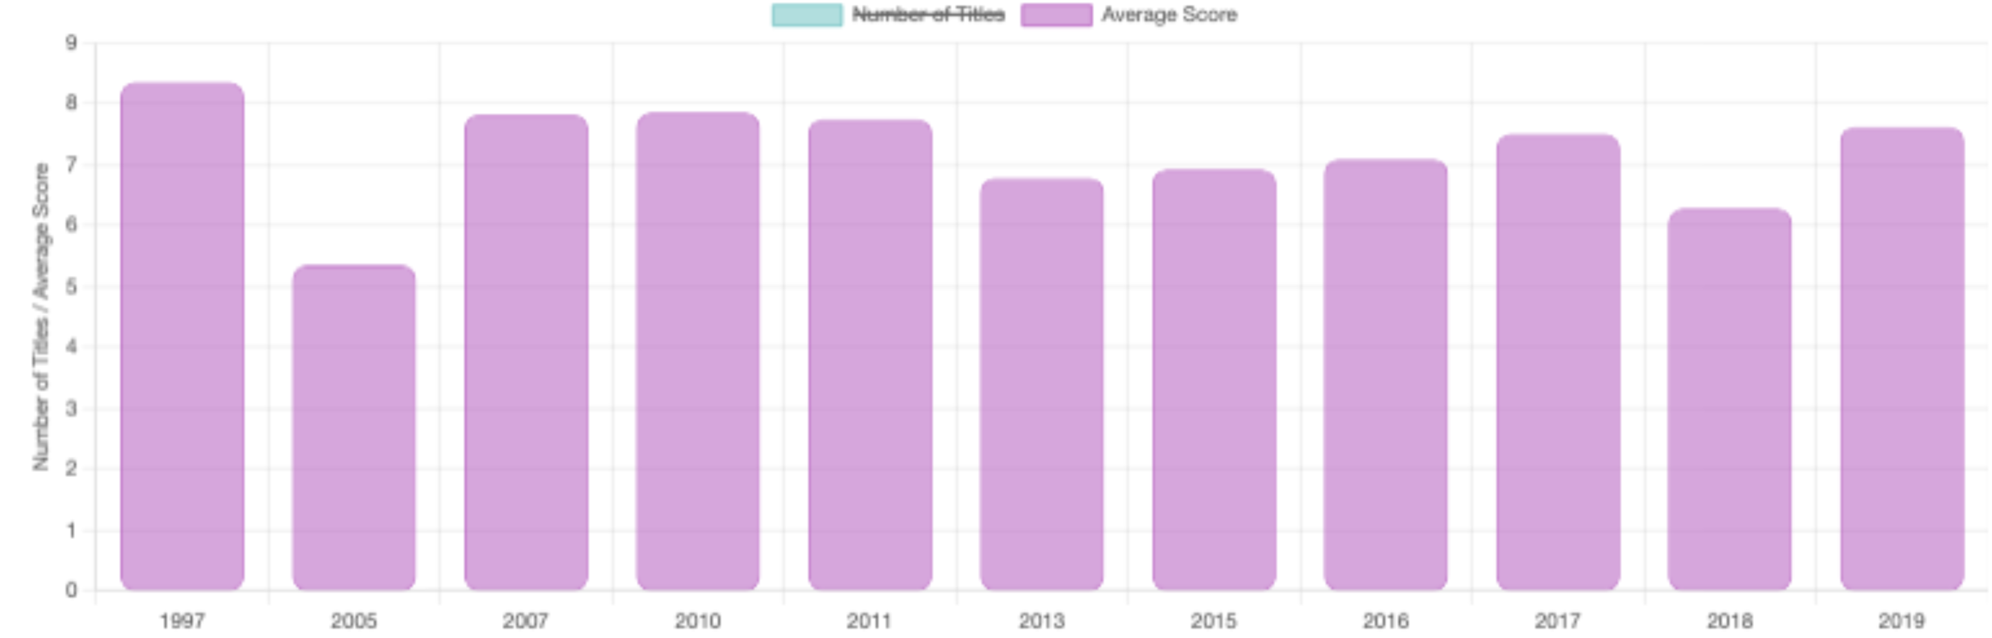
Barcharts

Slide 16
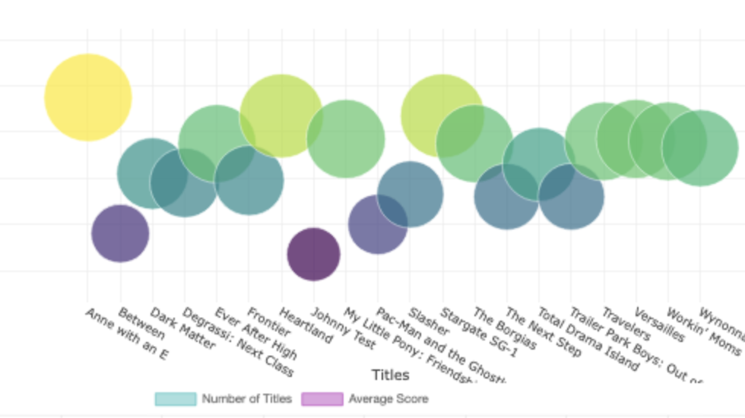
Bubble Chart

Slide 17
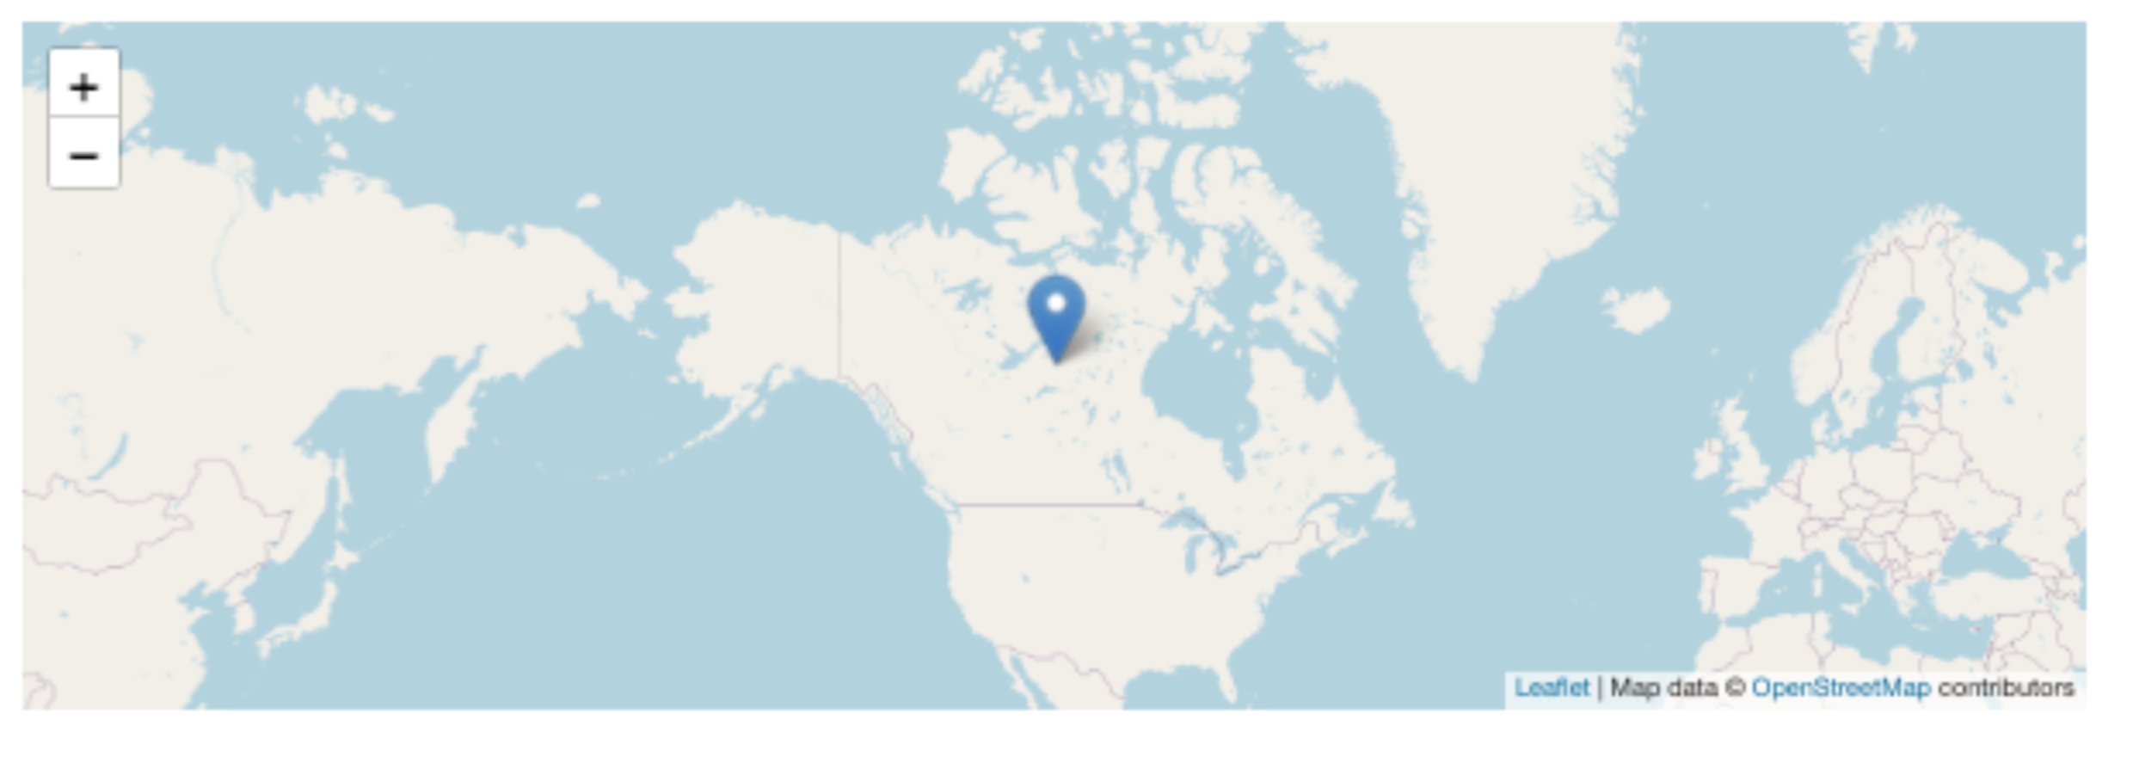
Map chart

Slide 18
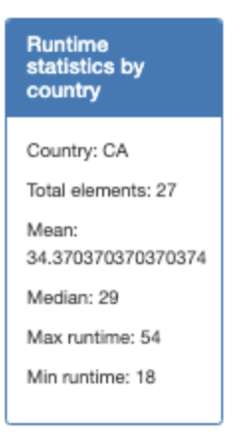
Text box

Slide 19
JS library
The new JS library that we explored in order to make one of the 4 visualizations in our Dashboard is called Chart.js

Slide 20

Chart.js is a free, open-source JavaScript library for data visualization, which supports eight chart types: bar, line, area, pie (doughnut), bubble, radar, polar, and scatter. Created by London-based web developer Nick Downie in 2013,

Slide 21
General data insights
The top 10 countries in number of titles are United States, India, Japan, Great Britain, Korea, Spain, France, Canada, Mexico & Brazil accounting for 70% of the total titles
The country with the highest Average Score for Movies is Korea with an avg Score of 8.45
The highest AVg. Score for shows is 8.8 and is in Co-productions for Argentina and Spain
the top 3 geners overall ar comedy, documentation and drama

Slide 22
General data insights
total number of
MOVIE 3285
SHOW 1852
Years with the most content
2019 717
2018 710
2021 674
The years with the highest rated content
1996 7.685
1992 7.65
1991 7.586
The years with the lowest rated content
1981 6.45
1954 6.35
1987 6.23
The show with the most seasons is Survivor (42)
How many seasons per show:
1 1018
2 359
3 178

Slide 23

Conclusion
In conclusion, our data visualization project demonstrated the successful integration of multiple technologies, such as JavaScript, Python, MongoDB, and HTML/CSS, to create an interactive dashboard that offers valuable insights into the movie dataset.

Slide 24

Thank you for your time and attention.

